Slide 1
Floor Meeting Talk Outline

Slide 2
Outline
Hardware and technique developmental journey.
What is multiplexing and its perks and pros/cons of current techniques? (fiducial marks and getting back to same spot) (2 slides)
Spawning idea: Why make machine and desired features (1 slide)
Manufacturing process CAD software, parametric modeling, videos such as 3D printer in action, parts working, how they fit together, etc. ()
Overview of entire system w/ highlighted key features (ie, pinch valve fluidic system, invisi-slip microfluidic device, Arduino communication system, software, microscope itself)
Go into each highlighted key section of system in more detail.
Microscope (light path super imposed on microscope, real image next to microscope popped out from camera with real dimensions and resolution).
Software (block diagram of code and software to what controls what w/ pycromanager as the bridge and image processor)
Arduino communication system (diagram explaining how commands are transferred and the MQTT server and the circuit board w/ arduino)
Invisi-slip (perks of FEP film, issues with FEP film in manufacturing, Manufacturing pipeline for device, images with and without device)
How to make it all work
Microscope (reflectance issue, autofocus slide, auto exposure algorithm tree)
Fluidic system (peristaltic pump flow rate vs RPM, fluidic mixing front graph)
Discovery of new bleaching solution
Story of Jerry Turner giving me lead and Biotium giving reaction, show minimal results on PubMed
Alexa 488 kinetics and fit with partial fluor intermediate model
Panel kinetics w/ fits w/ comps to H2O2 and LiBH4
Side by side pics of H2O2, LiBH4 and m-CPBA bleached tissue at a fixed time.
Images in action
Look at gifs of real time stain of tissues and real time bleach of them
Aggregate images of images with all the stains

Slide 3
What is Multiplexing?
Alexa 488
Alexa 568
Alexa 647
DAPI
4 emission marker colors can be cleanly separated at once
Multiplexing is achieving more markers on a sample than this limit

Slide 4
Why Multiplex?
Interrogate larger cell networks
Get more from rare samples
Reduce biological noise

Slide 5
Multiplexing Methods
Compensation
CODEX
CyTOF

Slide 6
Multiplexing Methods
Amplification and stripping
CyCIF

Slide 7
Pros Cons
Method | Pros | Cons
Compensation | Easy, no extra reagents | Max 7-8 markers, inaccurate
CODEX | Well validated and operating | Expensive, custom complexes required
Stripping
CyTOF | No cycles | Very expensive for machine, custom complexes
CyCIF | Cheap, readily available complexes and reagents | Labor intensive and slow

Slide 8

CyCIF step breakdown
Location Return
Stain
Image
63x
LSM 880
Total time with no labor: 135-150 minutes
Realistic time with labor: 4hrs
Bleach

Slide 9
CyCIF Issues
Labor barriers = long and tedious process
Getting back to same spot
(Fiducial mark method)
Cover Slipping

Slide 10
Microscope Requirements
Maximum FOV Camera
Upright Microscope w/ water dipping low mag objective
5 Color LED Illumination Source
Chamber to hold water bath and slide with its microfluidic device
Switchable Fluidic System
Repeatable Stage

Slide 11
Camera
Auto-CyPlex Scanner
0.97mm x 0.57mm images
Imaging area = 0.55mm^2
386 nm resolution
28% more imaging area
68% more resolution
RareCyte Slide Scanner
0.65mm x 0.65mm images
Imaging area = 0.43mm^2
650 nm resolution
5056 x 2960 pixel sensor
Extra small pixels (4.25um vs 6.5um standard sized pizels)

Slide 12
Invisi-Slip System
Fluid Flow
Objective
Fluid Flow
2500um
WD
FEP Film
1600um
100um Gap
Glass Slide (Tissue side up)
Smallish volume on top of entire slide surface (about 60uL)
No dilution of stain solution
FEP film has RI =1.333, PBS = 1.33, So if PBS is above and below the FEP film, it is effectively invisible
FEP film is a physical barrier, but not an optical barrier

Slide 13
File Format
DWG or DXF. DWG is a proprietary file format only for AutoCAD. DXF is the opensource equivalent.
Proprietary file formats are a scam and need to be discouraged to be developed. Use DXF!
While it appears initially that masks will have surfaces, don’t be alarmed that both DWG and DXF don’t have them. Its inherent in the design of those file types. They only save the borders. Don’t worry about making true surfaces due to this. Filling in enclosed surfaces or leaving them open is determined later in the software that generates the masks.
DWG File Format =
DXF File Format =
The world is now a better place due to the small, but powerful choice you just made.
“Gimmie all of those subscription fees”
-probably what this guy was thinking

Slide 14
FreeCAD Mode
Easy. Just make sketches. No need to extrude them too. Literally just bare sketches.
For organization, I recommend making bodies for each photomask which is done in part designer.
Huge tip. Make them parametric models.

Slide 15
Completed Microfluidic Device
15x18mm viewing window
FEP film sandwiched in PDMS
Iron oxide embedded in PDMS for magnetic alignment

Slide 16
CAD Designing Chamber
FreeCAD (Best open-source CAD software available)

Slide 17
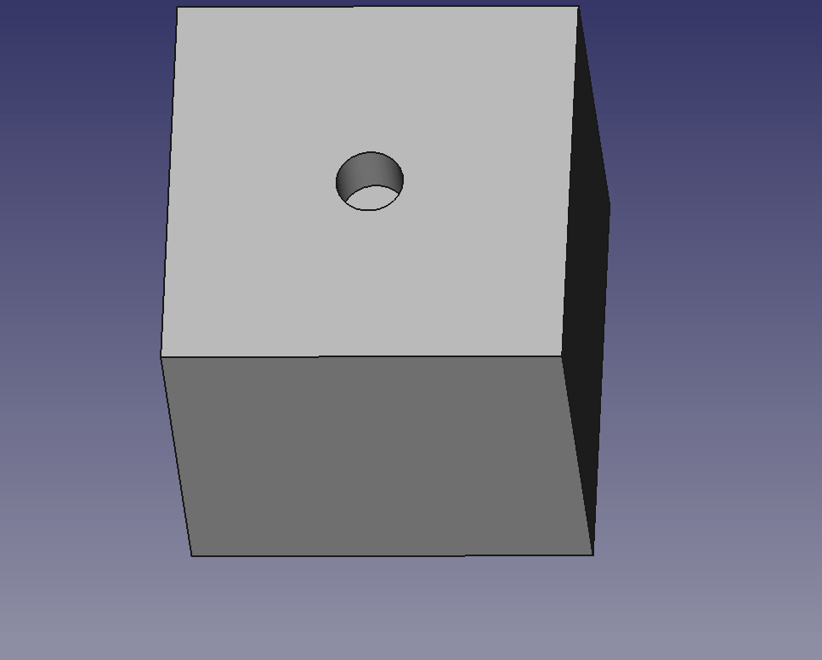
Parametric Modeling
Practice of assigning dimensional values from spreadsheet entries
Multiple dimensional values can be based on spreadsheet entry
Greatly accelerates prototyping process

Slide 18
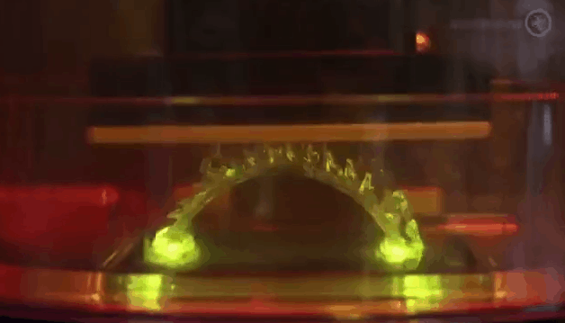
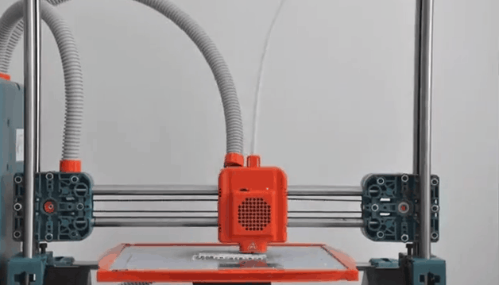
3D Printing Technology
Stereolithography (SLA)
UV cures resin
Undermount LCD panel patterns UV light
Fused Filament Fabrication (FFF)
Heats plastic filament until oozes
Extrudes oozing plastic through nozzle onto object
https://gfycat.com/healthyethicalafricanbushviper
https://gfycat.com/wilddescriptiveisabellineshrike

Slide 19
3D Printed Chamber (FFF)

Slide 20
Stage
Best engineered stage from ASI
Sub pixel repeatability over tissue section level displacements
Large displacements (125mm X and Y)
+-3 degree tilt stage to level slid

Slide 21
Fluidic System
8 channel pinch valve with multiplex mixer
Stepper motor driven micro peristaltic pump

Slide 22
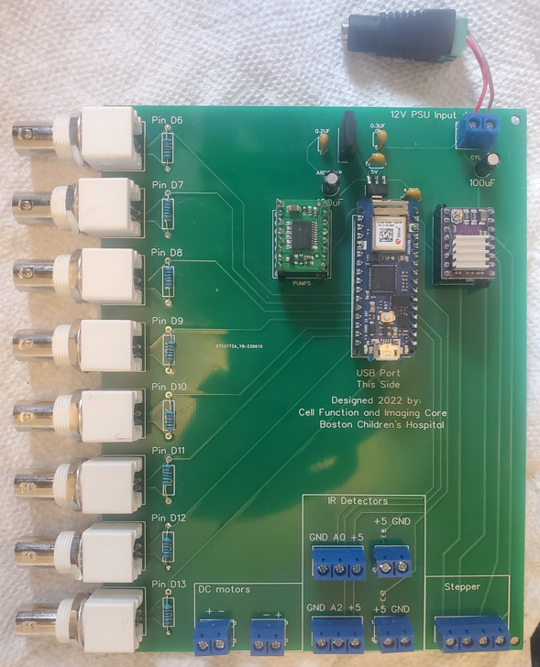
Software and Controllers
Arduino based fluidic controller
ASI tiger microscope controller

Slide 24
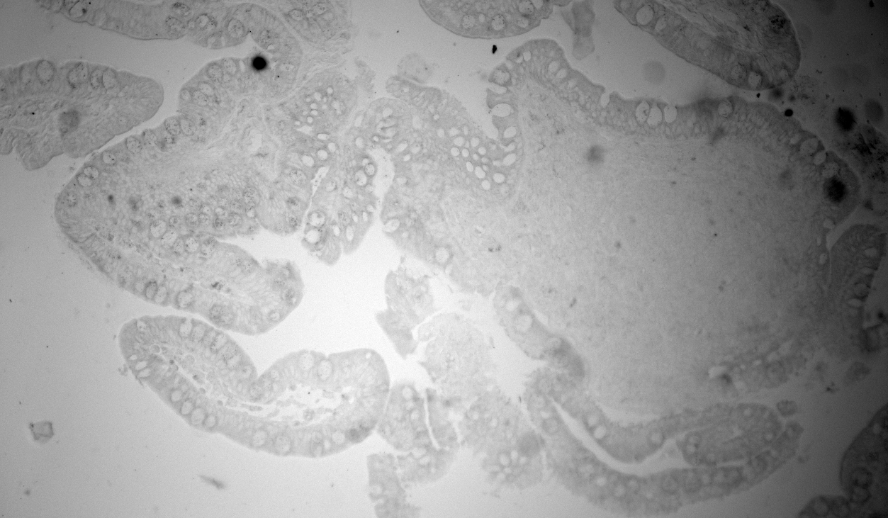
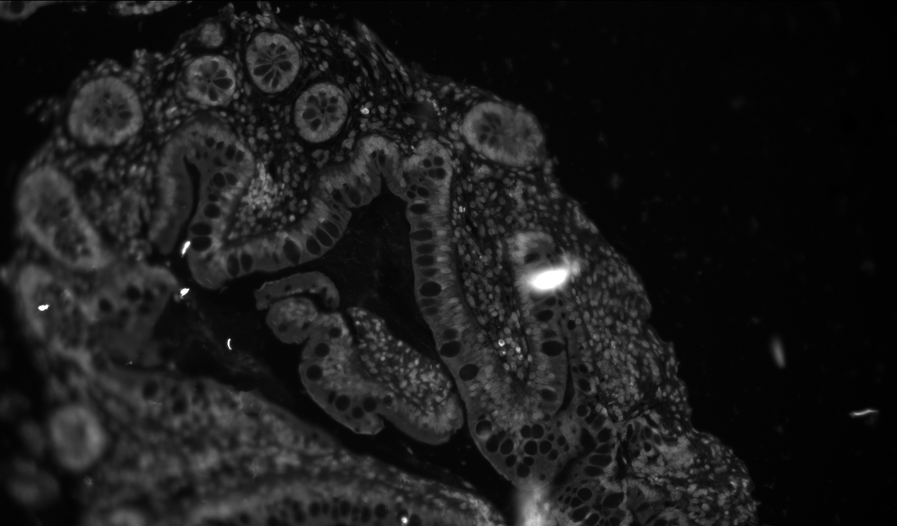
Reflection Issue
Image with 3D printed PLA housing behind slide. 2ms exposure (UV LED)
Image with blackened anodized Al dogtag behind slide. 1000ms exposure (UV LED)

Slide 25
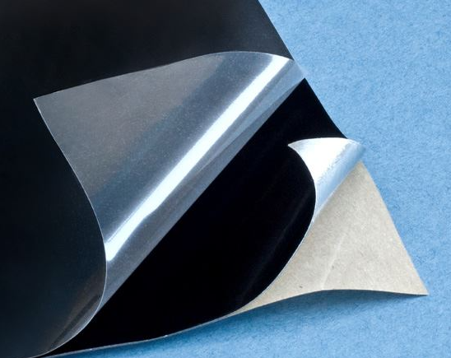
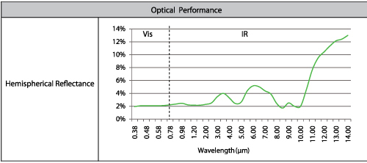
Anti-Reflective Solution

Slide 27
Auto Exposure vs Auto Focus: Chicken and Egg Problem
To auto focus properly, I must NOT have an over exposed image
To auto expose properly, I must be in focus
Picture is from: https://stevemouldey.com/2014/07/14/why-does-education-have-so-many-chicken-and-egg-arguments/

Slide 28
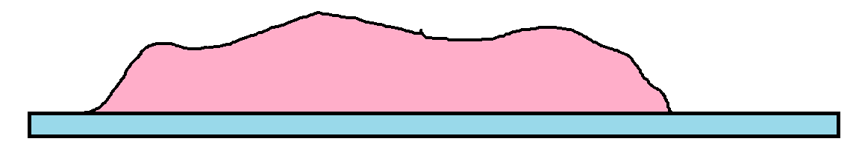
Solution
1. Scan over set Z range

Slide 29
Solution
2. Determine Relative Image Brightness Levels

Slide 30
Solution
3. Auto Expose on Brightest Z slice

Slide 31
Solution
4. Run Auto Focus over same range with determined exposure level

Slide 32
Solution
5. Run Auto Expose at in focus slice

Slide 33
Auto-CyPlex Time Breakdown
Location Return
Stain
Image
63x
LSM 880
Labor nearly eliminated
Total time Auto-CyPlex: 120 minutes
CyCIF time with labor: 4hrs
If bleaching time is trivial: 70 minutes
Bleach

Slide 34
Bleaching Alexa 647
Prilezhaev
Reaction
Add peroxide
High pH
Epoxide
Alkene
Structure Alexa 647
Vicinal Diol

Slide 35
Second Order Decay Graph Alexa 488

Slide 36
mCPBA Advantages
Approximately 3-fold faster than LiBH4
Less toxic
cheaper
Not reactive with water (hydrogen gas production)
Shelf stable in open container for 3 years (2 months for LiBH4)
No Bubbles!

Slide 37
Tau Chart
No Significant Bleach
No Significant Bleach
No Significant Bleach

Slide 38
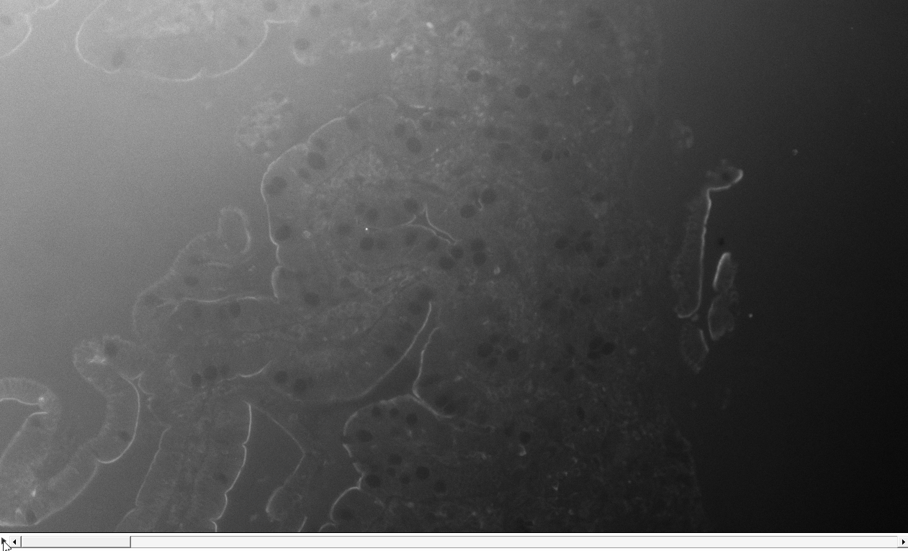
Staining Video over Time
Image is of Na/K ATPase Alexa-647
Each frame is 5mins apart, 300ms exposure.

Slide 39
Time Lapse Int Graph
Stain Box
Background Box
37 minutes is not enough to approach plateau region. At most, 37 min is the start of that region. Not enough data to be confidence though.
Assuming uniform staining, S/N ratio is around 15 as intensity = 2200 and stdev = 150.

Slide 40
Antibody Evaluation Imaging?
Stain Box
Background Box
Binding kinetics is proportional to [antibody]*[epitopes]
If we assume antibody [C] is in such excess that its number negligibly changes over time, we can estimate % epitopes remaining and thus plateau signal.
Exp decay fit indicates 673 was the initial burst rate and ending rate was 111, that means 83% of epitopes were bound to. This supports initial stance that plateau region was being entered in the Int vs time graph.

Slide 41
Aggregated image final

Slide 42
What to do with Images
Diagram for analysis Krish made

Slide 43
Future
“Smart” focus algorithm. Focus on tissue, disregard junk, adapt to tissue being in multiple planes
New chamber with heating element, magnetic pressure plate and encased magnets.

